Slide 1

Project proposal
Exploring expression programs of heterogeneity in pan-cancer cell line data
March 7th,2022
John Lin, Amrita Nallathambi, Jess Byun

Slide 2

Overview
1. Introduction
Background of pan-cancer heterogeneity
Aims
2. Data & Methods
Datasets
Overall Workflow scheme
cPCA
MILO
DBSCAN
3. Discussion
Expected Challenges
Work Timeline

Slide 3
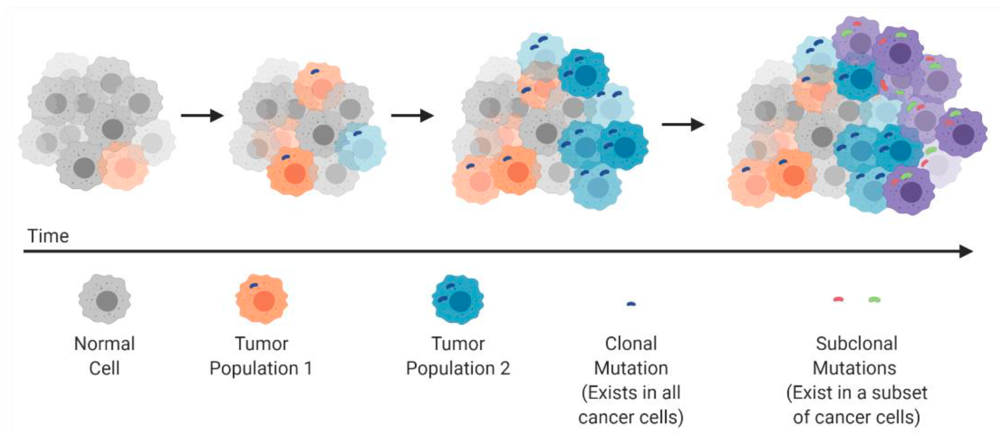
Background
What is Intra-Tumor Heterogeneity?
N el-Sayes, et al. Cancers. 2021.
Notes:
cellular plasticity and heterogeneity are fundamental features of human tumors that play a major role in disease progression and treatment failure
Genetic diversity, epigenetic plasticity and interactions within the tumor microenvironment
the significance of this is that
rare subpopulations of tumor cells may be an underlying cause of resistance or may facilitate metastasis

Slide 4
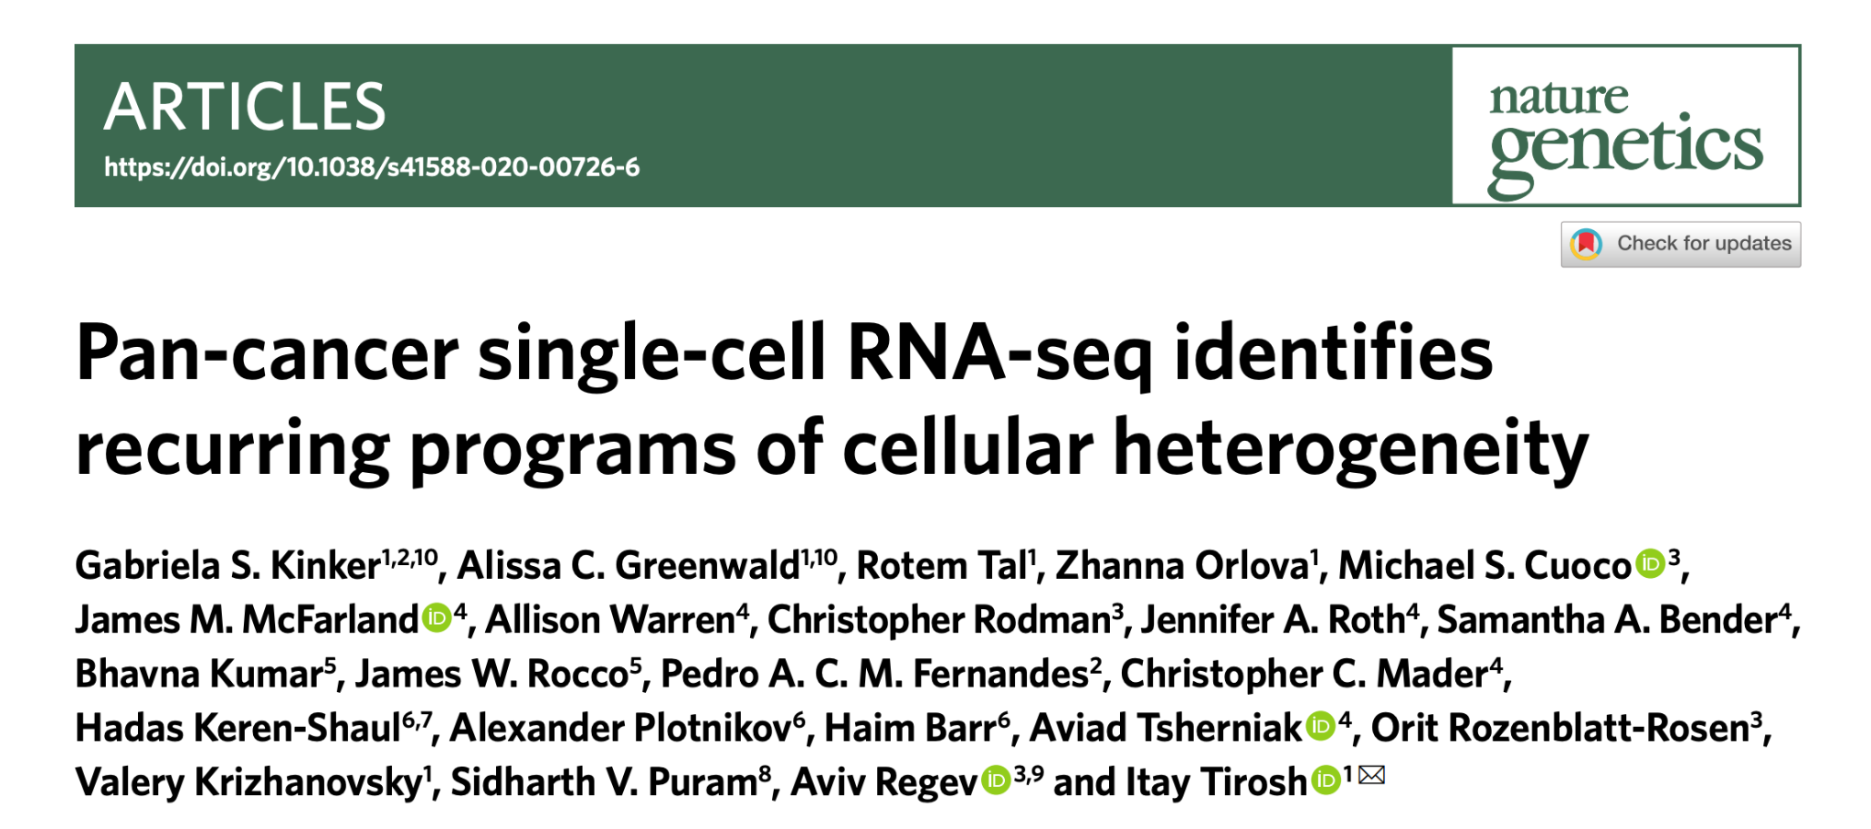
Identifying Recurring Programs of Heterogeneity (Tumors vs in vitro cell lines)
Notes:
describes the landscape of heterogeneity within diverse cancer cell lines and identifies recurrent patterns of heterogeneity that are shared between tumors and specific cell lines
study intratumor heterogeneity (ITH)
identify common expression programs that varied within multiple cell lines
patterns of heterogeneity were as similar between cell lines from the same pool as they were between cell lines from different pools
Extensive variability in gene expression was identified across cells within individual cell lines

Slide 5
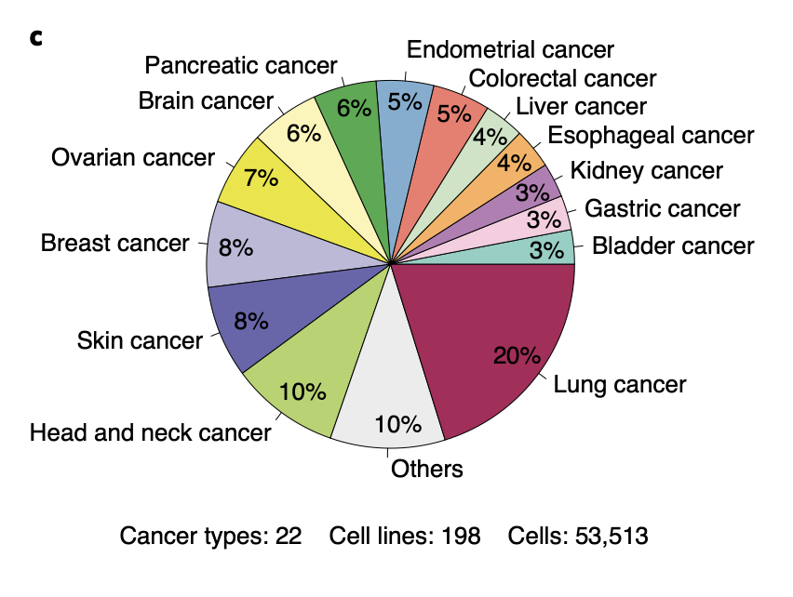
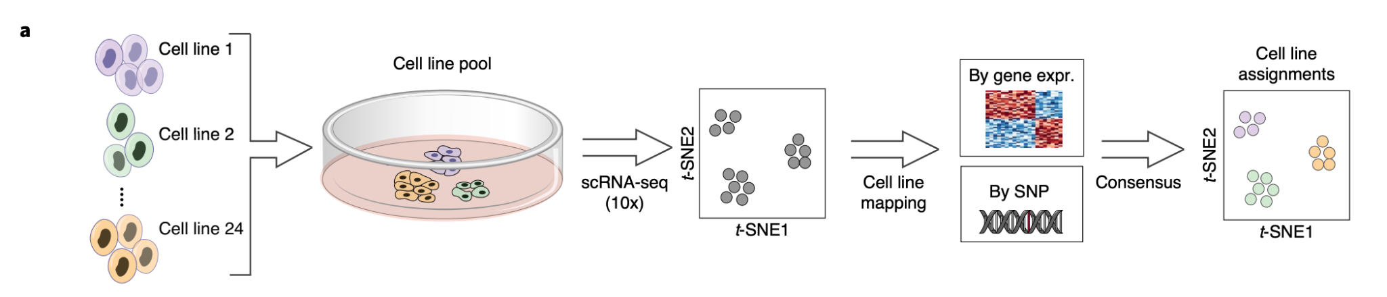
Background
Methods:
Multiplexed single-cell RNA seq profiling
Dimensionality Reduction and Clustering
Mapping to bulk RNA-seq data
Notes:
multiplexed single-cell RNA-seq to profile 198 cancer cell lines from 22 cancer types
using tsne and dbscan to analyze the scrnaseq data
cells were clustered by their global expression profiles, and each cluster was mapped to the cell line with the most similar bulk RNA-seq profile
what we’re interested in is the mapping of scrnaseq to bulkrnaseq

Slide 6
Aims
Can we identify similar programs by clustering bulk RNA-seq data instead?
Comparing graph-based clustering to non-graph based method
Identify other additional programs from the data?

Slide 7
Overview
1. Introduction
Background of pan-cancer heterogeneity
Aims
2. Data & Methods
Datasets
Overall Workflow scheme
cPCA
MILO
DBSCAN
3. Discussion
Expected Challenges
Work Timeline

Slide 8

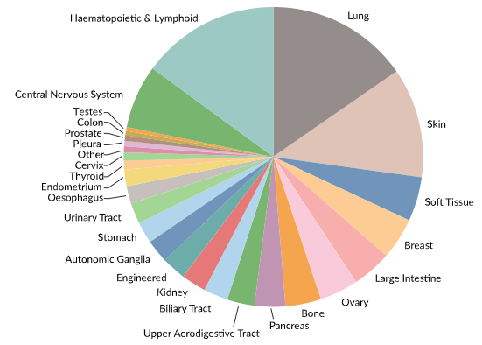
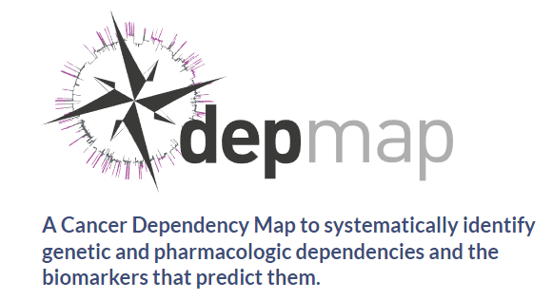
Datasets
Dataset: Bulk RNA-seq
1158 cancer cell lines, 56,318 genes

Slide 9
Biological & Biomedical Sciences Program
Input data
RNA-seq (n=1158 cell lines)
Pre-processing
Remove non-expressed gene, select the top 5,000 most expressed genes
Dimension reduction
Contrastive Principal component Analysis
Clustering
MILO
DBSCAN
Output data
Biological functional analysis both clustering method output data

Slide 10
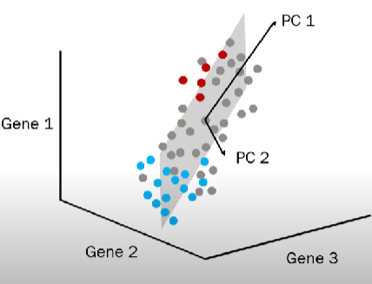
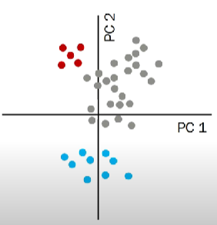
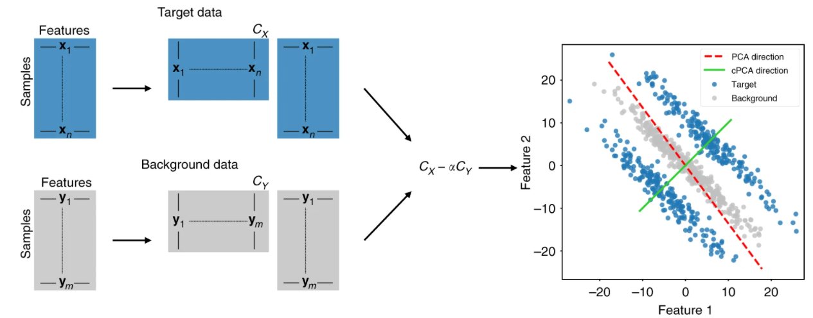
cPCA
Principal component analysis (PCA): High variance directions give the most interesting directions
Contrastive PCA (cPCA)
Abubakar Abid, et al. Nat Commun. 2018.

Slide 11
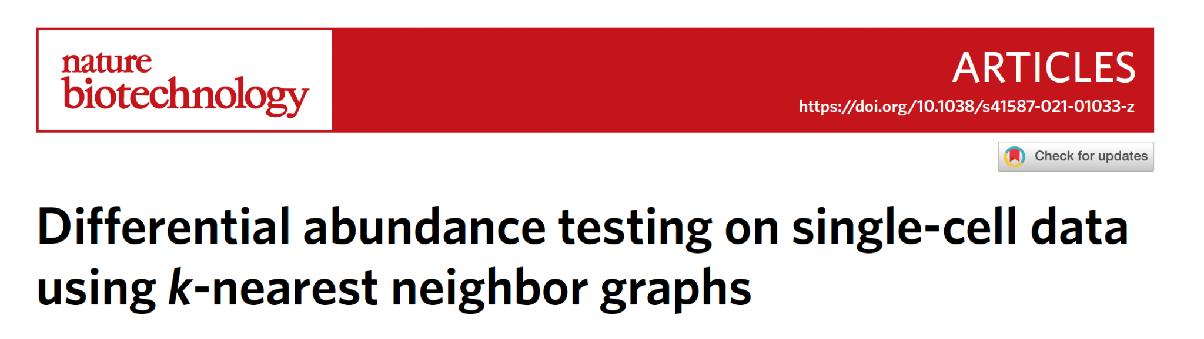
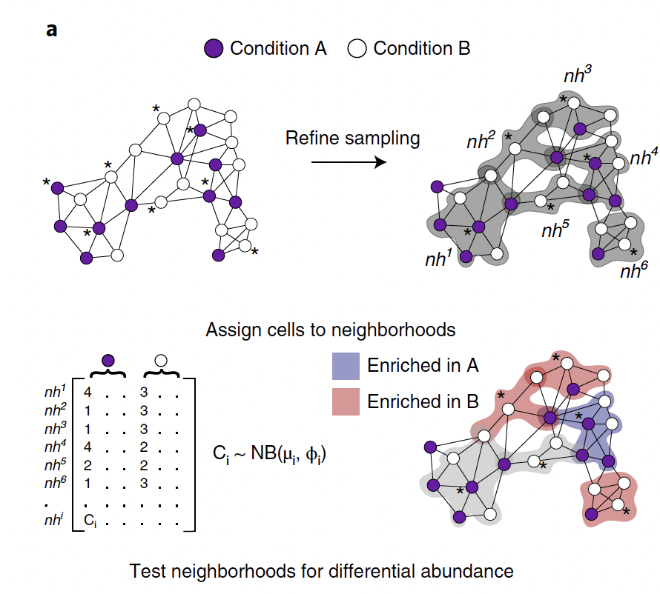
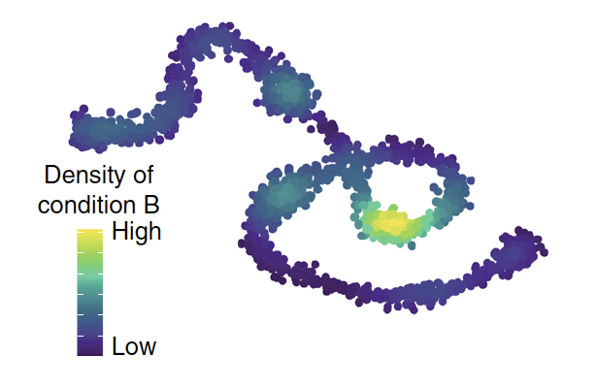
MILO
Avoids discrete clustering
KNN graph-based
puts nodes into neighborhoods (can overlap)
Negative binomial GLM for differential abundance testing
* index cell
Emma Dann, et al. Nature Biotechnology. 2022.

Slide 12
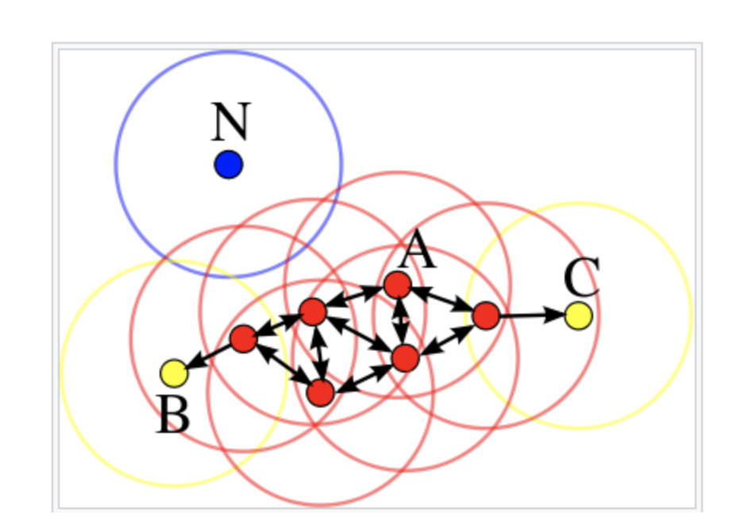
DBSCAN
Density-based spatial clustering of applications with noise…
Clustering-based
Good at finding high density regions and outliers
Starting point chosen at random
User defines:
eps (radius, defines neighborhood points)
minPts (min # points in cluster)
Point Classes:
Core Point (red)
Border Point (yellow)
Outlier Point (blue)
eps = some distance
minPts = 4
Soner Yildrim. DBSCAN Clustering — Explained. 2020.

Slide 13
Overview
1. Introduction
Background of pan-cancer heterogeneity
Aims
2. Data & Methods
Datasets
Overall Workflow scheme
cPCA
MILO
DBSCAN
3. Discussion
Expected Challenges
Work Timeline

Slide 14
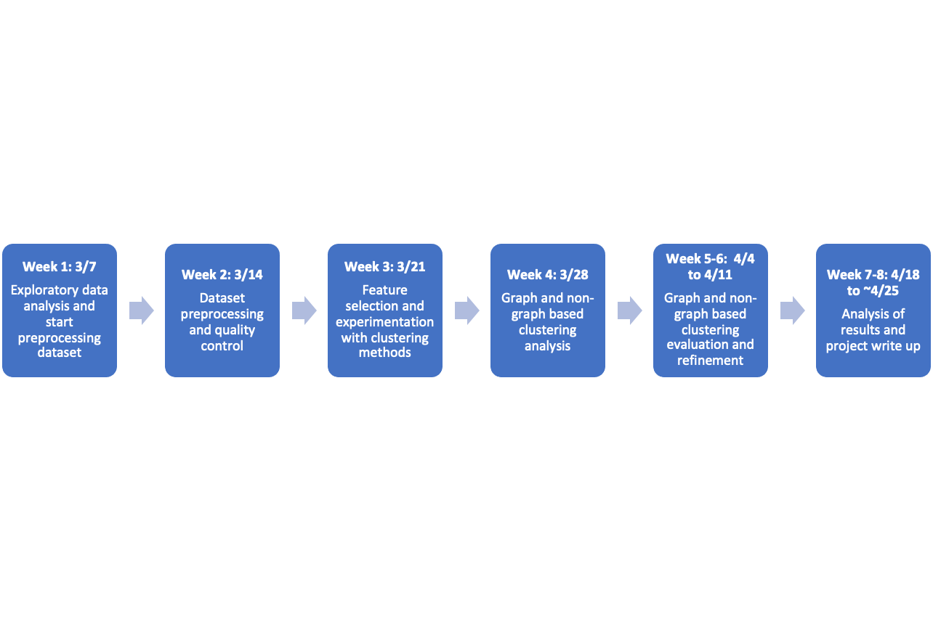
Discussion
Expected Challenges
Dataset preprocessing and quality control
Gene selection and dataset reduction (bulk RNA-seq has 50,000 genes)
Batch effects, varying coverage, alignment quality, etc.
Revealing patterns of heterogeneity may be more difficult with bulk RNA-seq
Alternative methods?
Work Timeline
Pan Cancer Project Repo

Slide 15
Supplemental Slides

Slide 16
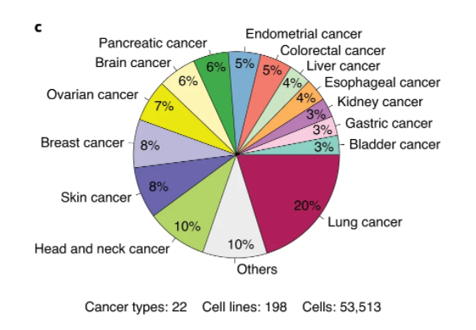
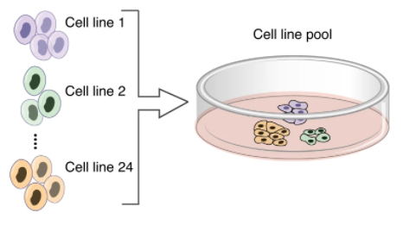
Datasets
Dataset: scRNA-seq
198 cancer cell lines,22 cancer type
Total 8 pools generated consisting of 24-27 cell lines + HNSCC cell line (8 cell-lines)

Slide 17
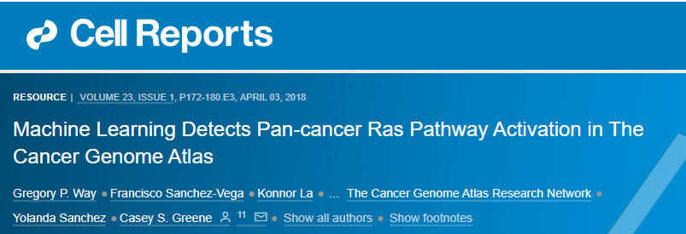
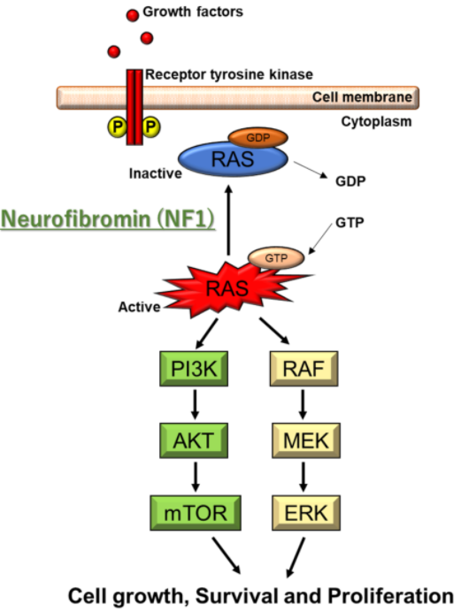
workflow
Biological & Biomedical Sciences Program
RAS/MAPK pathway?
Tamura R Mol. Int. J. Mol. Sci. 2021, 22(11), 5850

Slide 18
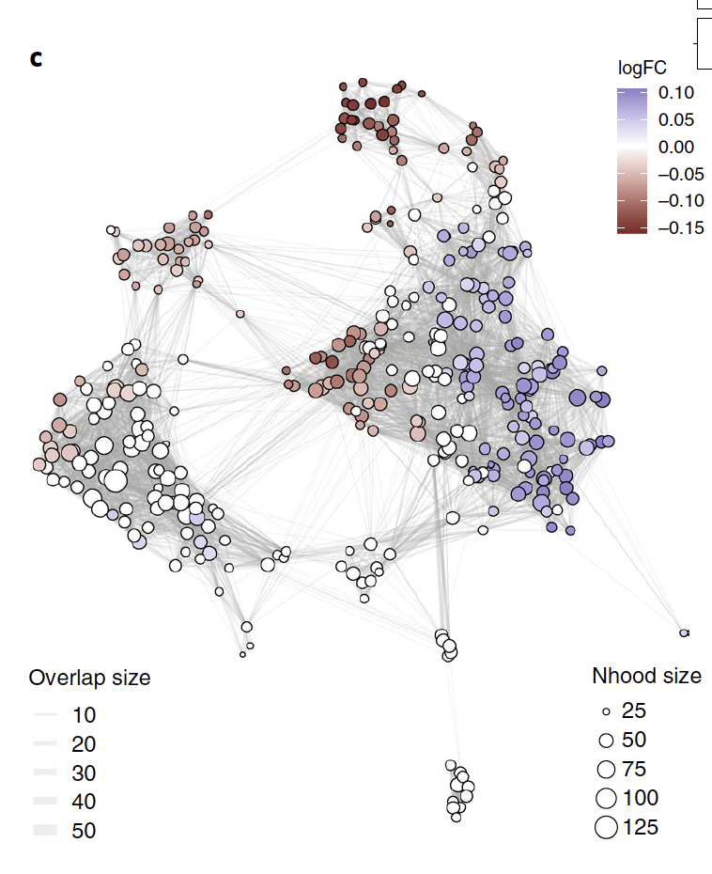
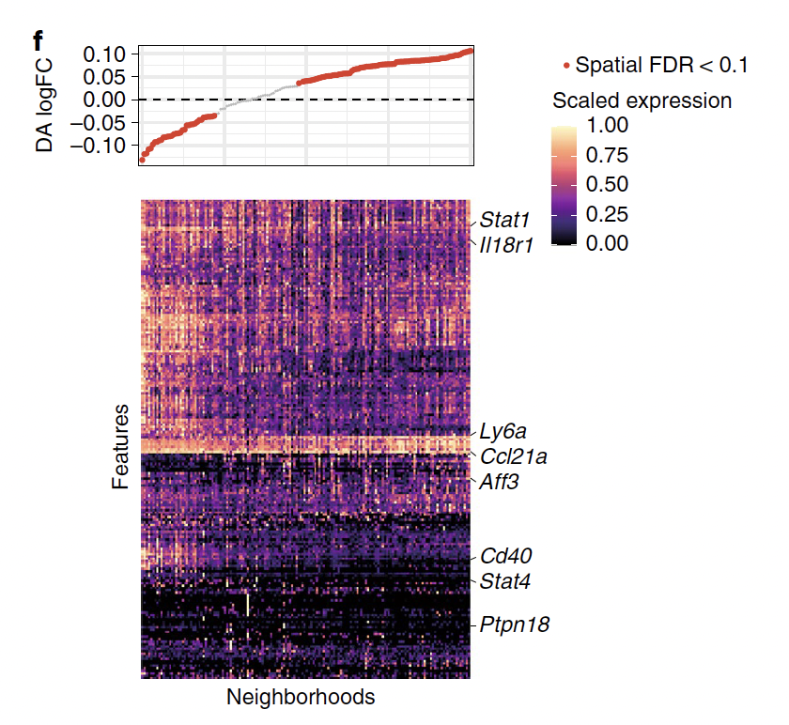
MILO detects compositional changes in mouse thymus
Emma Dann, et al. Nature Biotechnology. 2022.

Slide 19
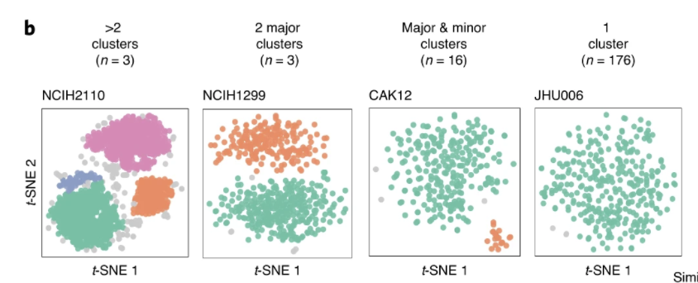
DBSCAN to identify discrete subpopulations
From Pan-cancer scRNA-seq study…
authors used DBSCAN to identify subpopulations within cell lines
discrete patterns of heterogeneity
Gabriel Kinker, et al. Nature Genetics. 2020.

